Slide 1

Web Health Informatics – Mobile Sensor Data Representation
Presented by : Tanvir Singh Sokhi(0668762)
Linash Zargar(0668249)
Kunwar Krishna Swaroop(0679298)
Presented to : Dr. Vijay Mago

Slide 2
Techniques
Hardware requirement
Mobile phone
Android / IOS
Establishing connection and detecting the port via data cable
Laptop
Android Studio
Java
Use of MySql /Php
(Or storing the data on cloud to show the final output)

Slide 3
Different Approaches
Three different approaches were used to achieve the final outcome
Using cloud storage
Online web-hosting (through 000webhost.com)
Using MySQL database to display final output

Slide 4
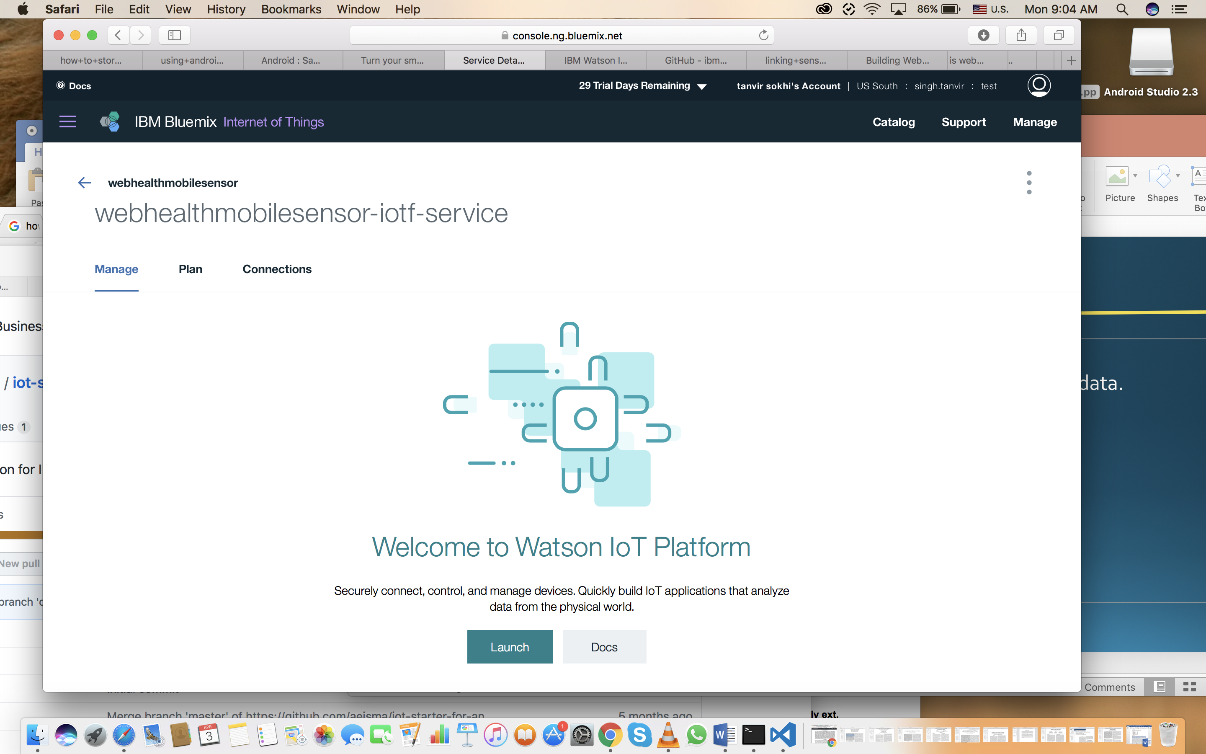
Creating an IOT App
Installing and configuring app.
Creating a bluemix app to visualize sensor data.
Connecting the sensor data with cloud.

Slide 5
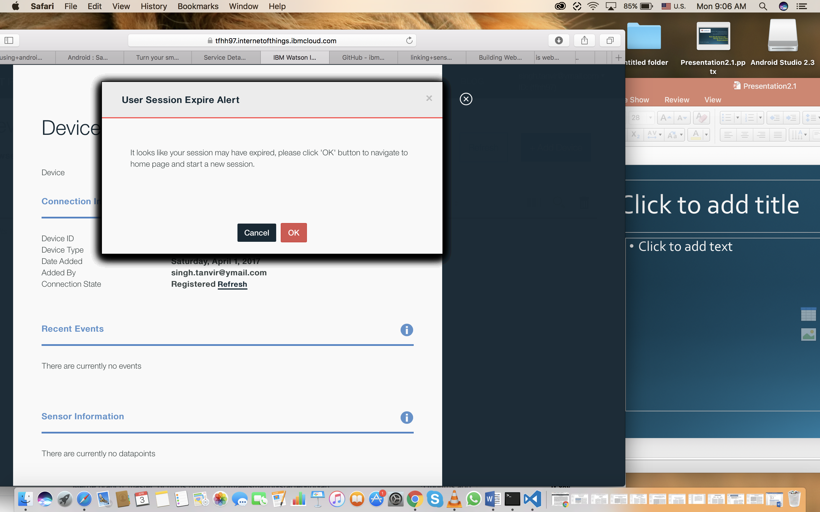
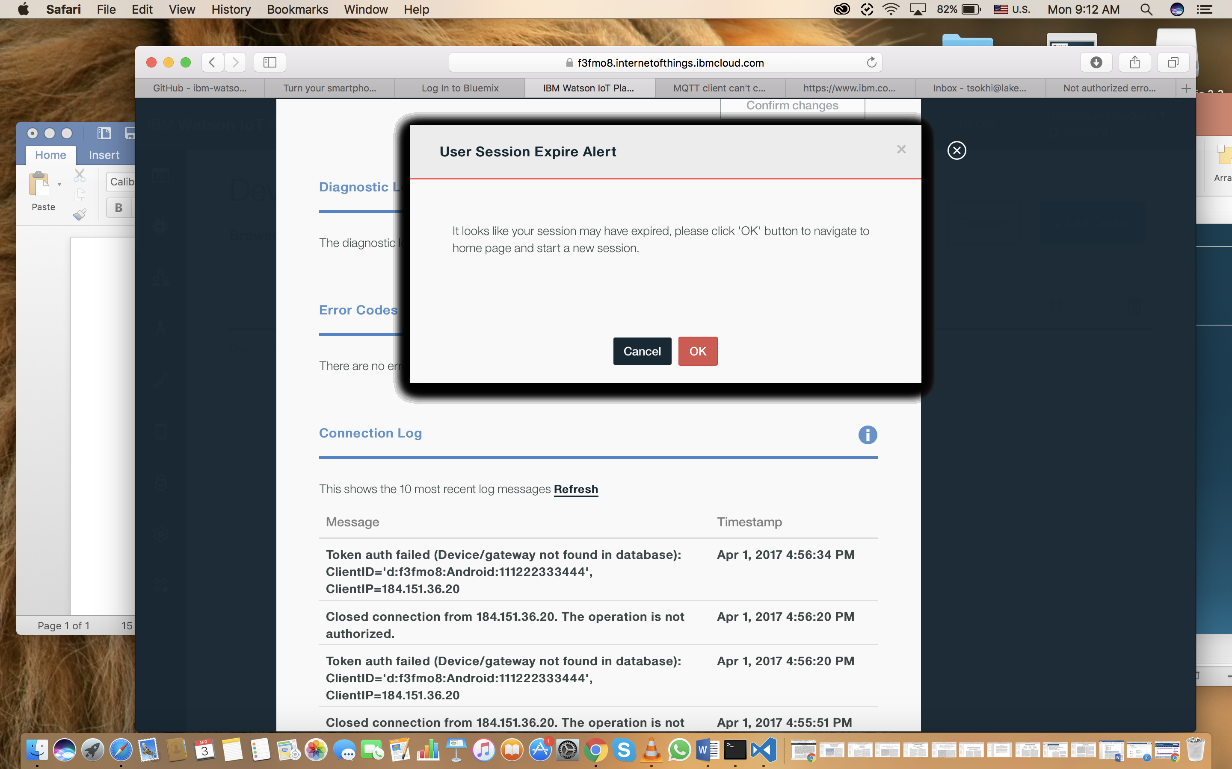
Issues with cloud connection

Slide 6
Key features
Collection of raw data values from sensors
Accelerometer
Light sensors
Simulation of data via Android studio
Representation of data values on webpage

Slide 7
Output

Slide 8
Conclusion
Collecting data
A peak at raw data
Applications
Focus on extraction

